Slide 1




Hypothesis Testing
by
Priya Bhatia
Data Scientist, Mentor and YouTuber
https://www.linkedin.com/in/bhatia-priya/
https://github.com/priya6971
https://www.youtube.com/c/PriyaBhatia/

Slide 2
Hypothesis Testing
Attempts to refute a specific claim about the population parameter based on the sample data
Hypothesis testing usually stated as
conditions that is doubted: Null Hypothesis
condition that we believe in: Alternate Hypothesis
Examples:
Null Hypothesis: Heart attack has no link with drinking coffee
Alternate Hypothesis: Drinking coffee increases the chances of a heart attack

Slide 3
Important Note
To reject null hypothesis is to conclude that it is false
To accept null hypothesis does not mean that it is true - it just indicates that we do not have enough evidence to believe otherwise
Thus, we either reject a hypothesis or we fail to reject it

Slide 4
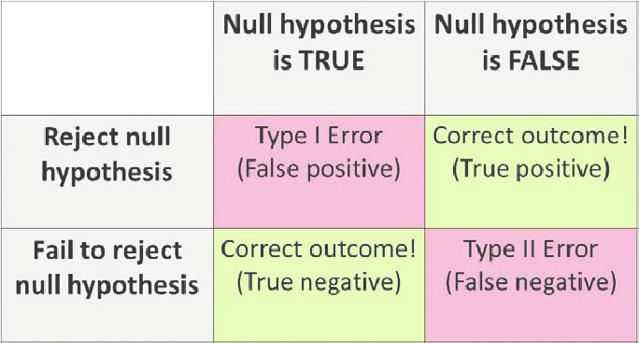
Type | and Type || Errors

Slide 5
Example Demonstration
Inspector has to choose between certifying a building as safe or saying that building is not safe.
Now, there can be two hypothesis:
Building is not safe - Null Hypothesis
Building is safe - Alternate Hypothesis
Type | error is committed if we reject “Building is not safe” when it is not safe.
Type || error is committed if we fail to reject “Building is not safe” when it is safe.

Slide 6
Thank you !
https://www.linkedin.com/in/bhatia-priya/
https://github.com/priya6971
https://www.youtube.com/c/PriyaBhatia/
Queries?

